Slide 1
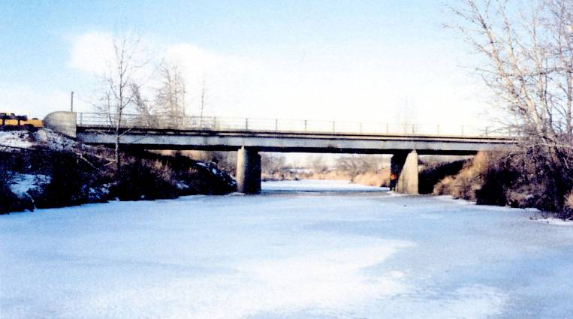
Notes:
BF278 – Hwy 2A over Battle River near Ponoka
Why does it matter?
Typical bridge
Looks like lots of capacity, when flow is low

Slide 2
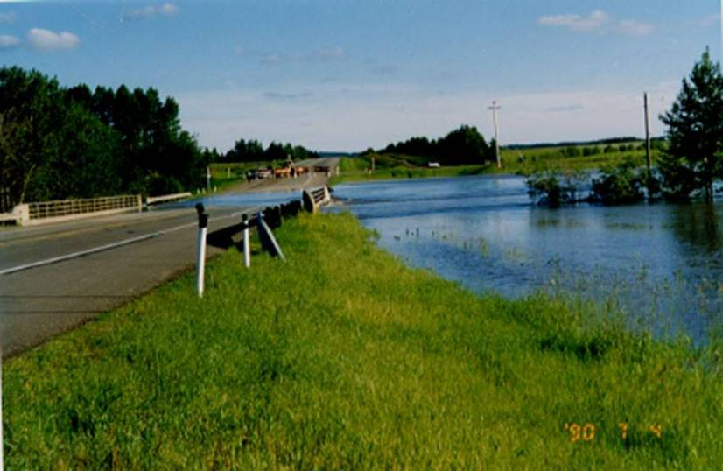
Notes:
July 1990 flood:
More than 20 times the flow
Water over bridge and approach road – closure, potential damage, potential increased flooding upstream

Slide 3
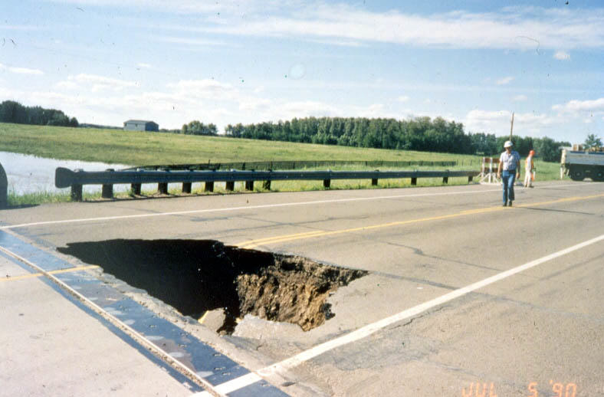
Notes:
After flow receded, large void was observed behind

Slide 4
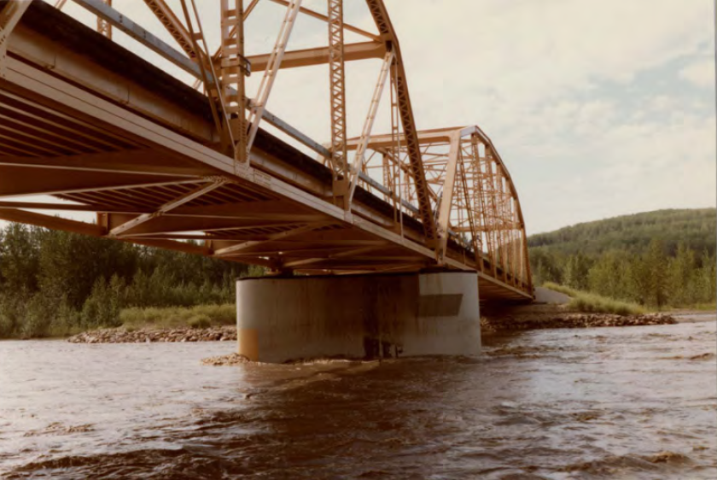
Notes:
Hwy 734 over Simonette River near Grande Prairie
1983 Flood
Holding up well

Slide 5
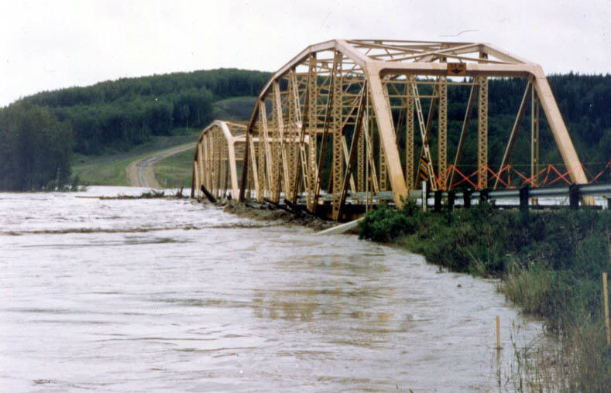
Notes:
Loss of Bridge:
Hwy 734 over Simonette River near Grande Prairie
1987 Flood
Buoyant and horizontal force

Slide 6
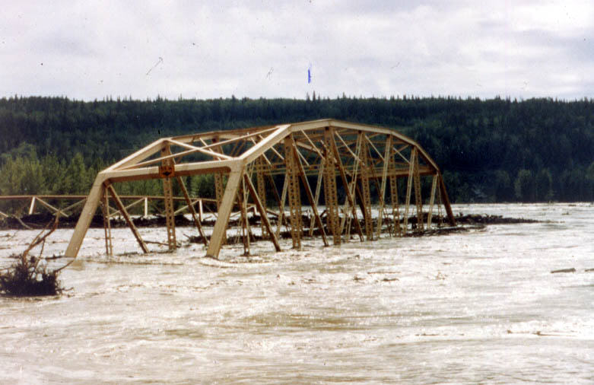
Notes:
Superstructure carried away and damaged

Slide 7
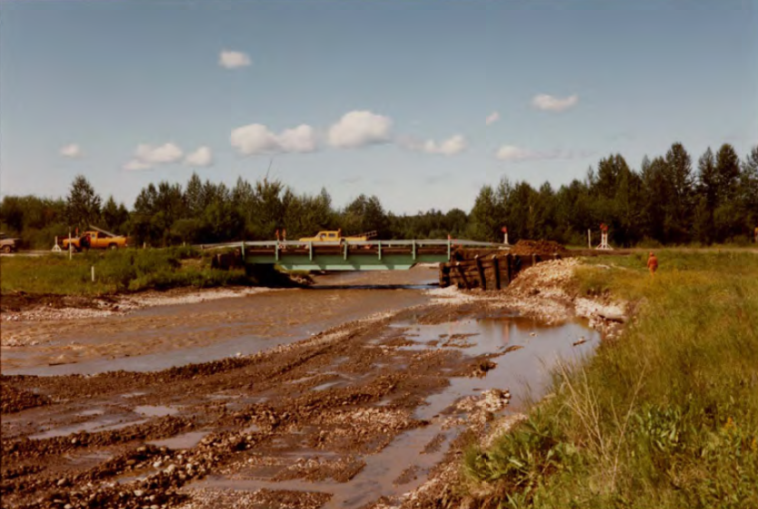
Notes:
Hwy 33 over Island Ck near Kinuso
Post 1983 flood
Some repairs to abutment

Slide 8
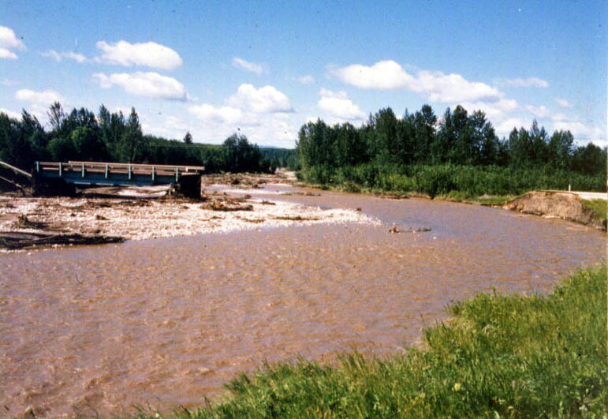
Notes:
Loss of Road:
Hwy 33 over Island Ck near Kinuso
Bridge still standing, but is now an island

Slide 9
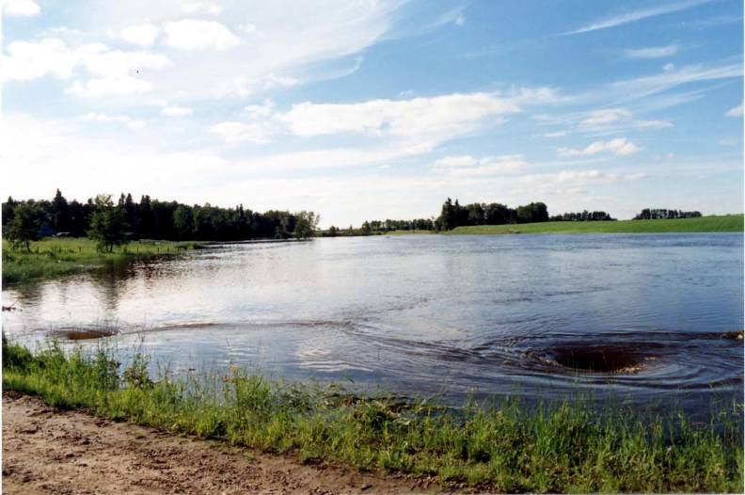
Notes:
Constrictive opening - Note :
Higher water levels upstream (flooding)

Slide 10
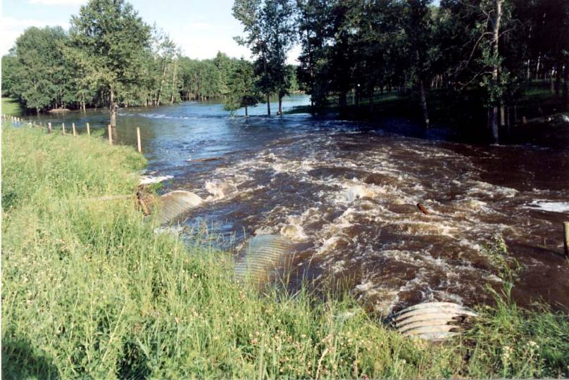
Notes:
Constrictive opening - Note :
Higher velocity d/s - erosion

Slide 11
Water Surface
V = Q
A
Y
A
Q
Thalweg
Notes:
Some basic Definitions:
Q – flow (discharge), volume of water passing section in given amount of time – cms
Y – flow depth (m)
V – mean flow velocity (m/s)

Slide 12
Sun
Rain
Hail
Snowmelt
Snow
Mountains
Lakes
Streams
Evaporation
Groundwater
Rivers
Oceans
Notes:
Hydrologic Cycle

Slide 13
Area
Shape
Slope
Storage
Density
Vegetation
Soil Type
Initial Moisture
Notes:
Many complex parameters affect runoff

Slide 14
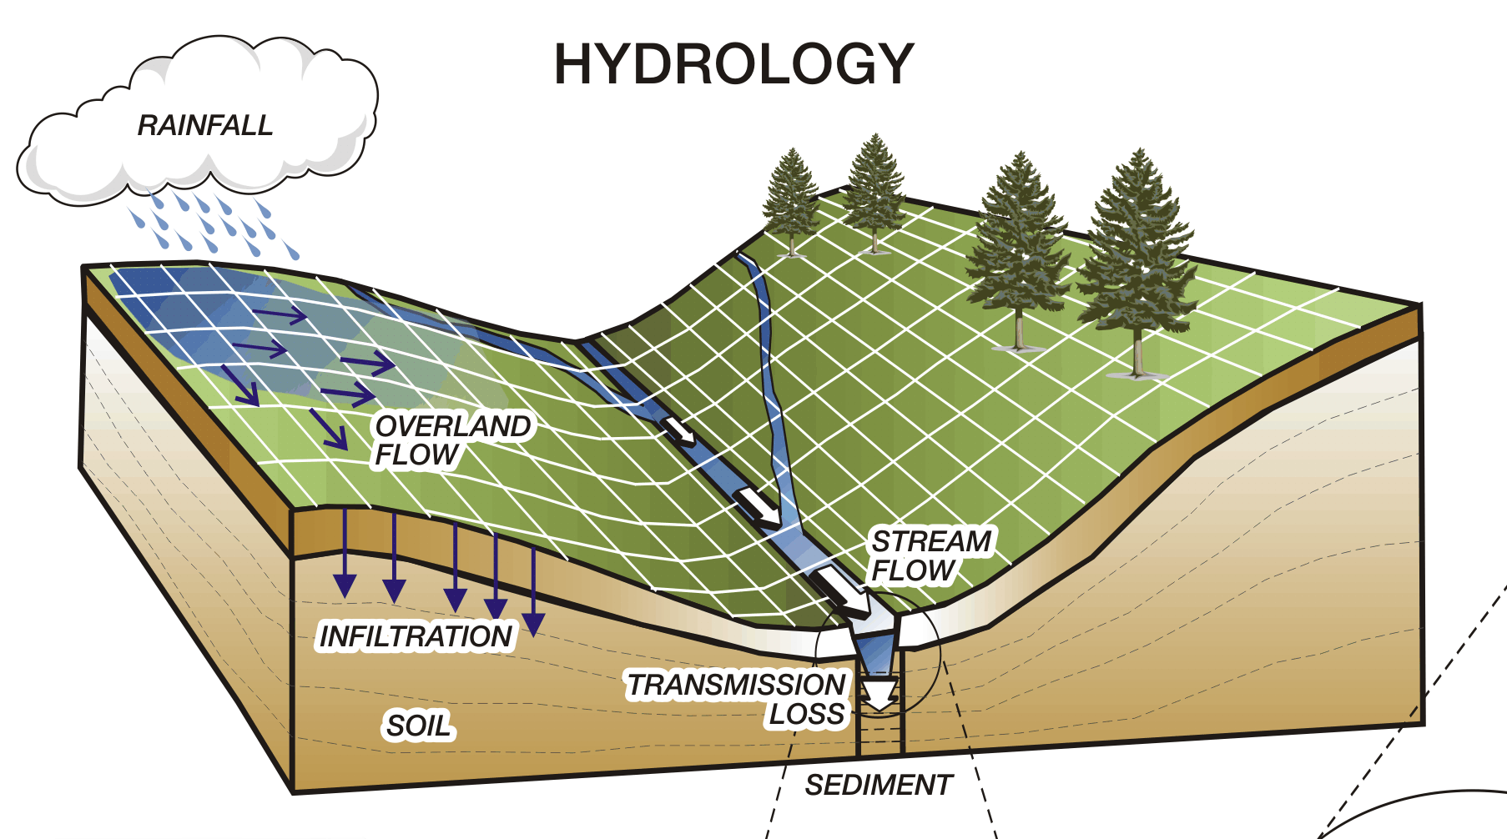
Options
Statistics
Model
Notes:
Frequency Analysis – no connection with Physics:
No true distribution
Most data not floods
Very sparse data
Extreme data very inaccurate
Why 1:100?
Hydrologic Model – too complex:
Diversity of parameters and inputs
Calibration data not available
Input vs output – no correlation
Still need a design input

Slide 15
Notes:
Actual observations of extreme events:
Longest records in province
All major basins represented
Largest floods trend to a certain range

Slide 16
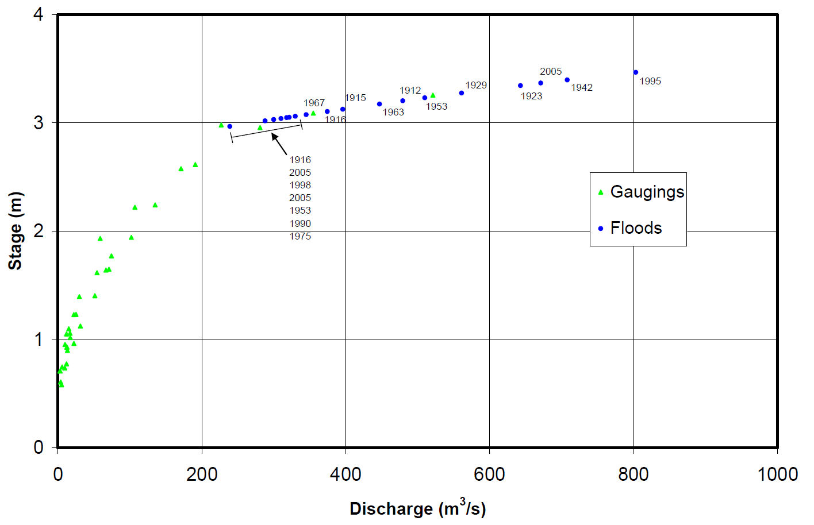
Notes:
Extreme Example – Highwood River at High River:
Within 0.3 – 0.5m of highest flood ~ 18 times in 100 years
Assigned frequency is irrelevant, we know the magnitude

Slide 17
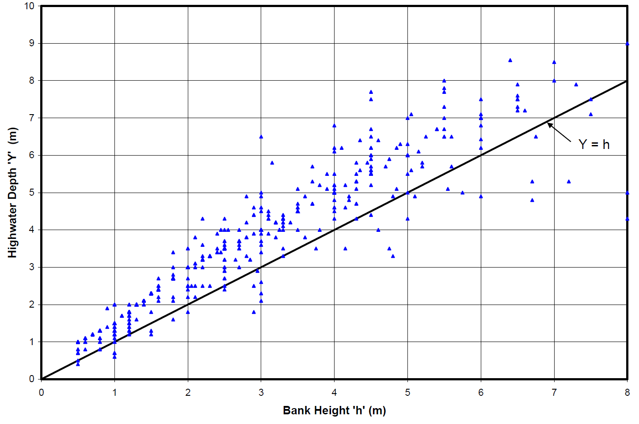
Notes:
Analysis of HIS DB Data:
Highest observed HW related to bank height
Most within a certain amount above bank height - flood

Slide 18
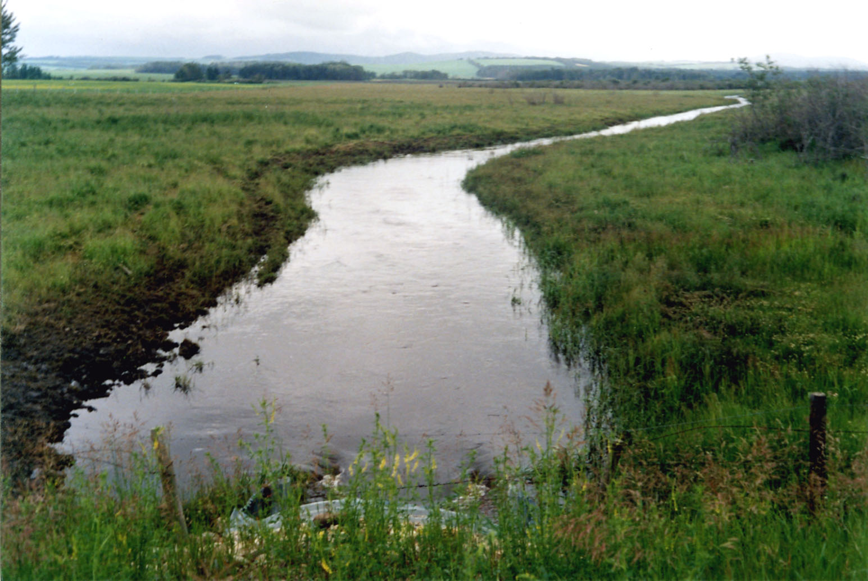
Notes:
Physics:
Most channels have trapezoidal shape up to bankfull
Beyond this level, much of water goes into storage
Does runoff make the channel or does channel control the runoff? - Yes

Slide 19
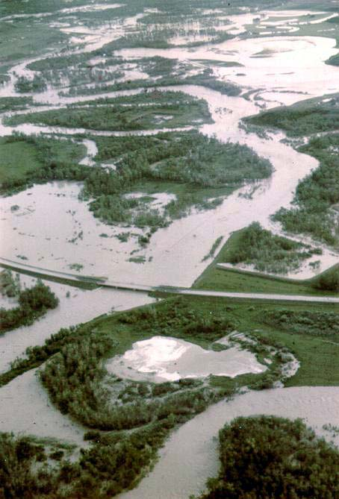
Notes:
Hwy 18 over Pembina River – 1986 flood:
Significant storage of flood water on floodplain
Acts as reservoir – routes peak flows

Slide 20
Notes:
Example of flood hydrograph routing:
Peak drops as flood wave passes
Hydrograph spreads out
Water enters floodplain storage before peak and then re-enters stream after peak

Slide 21
Hydrotechnical Design Guidelines
Component | Governs | % System
Channel Capacity | Most channels | > 80%
Historic HWM | Large streams | ~ 10%
Runoff Potential | Small basins | < 5%
Notes:
HDG:
Established in 2001
3 components
Examples provided for > 1500 bridge sites in HIS
Historic HWM seldom >> Qcc, usually confirms
Runoff Potential – seldom governs, important when it does

Slide 22
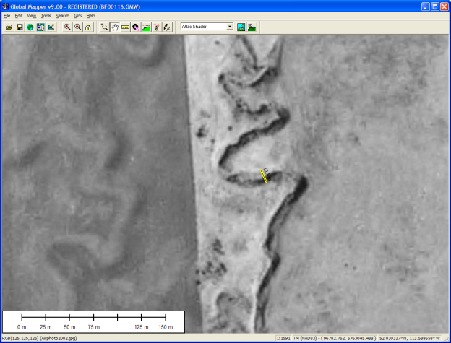
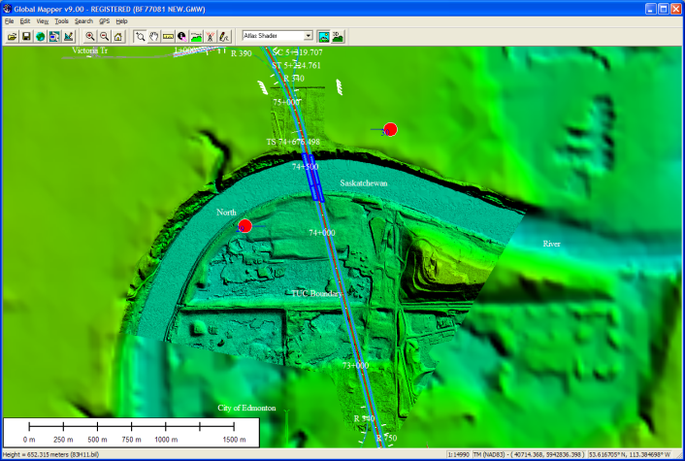
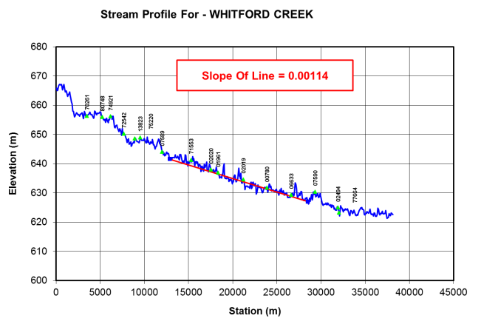
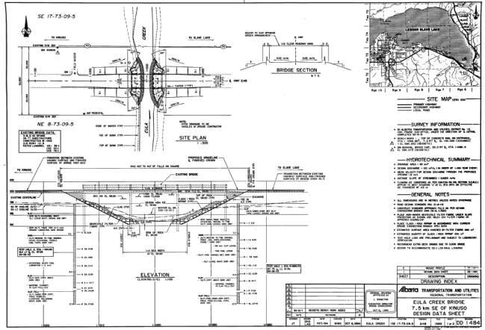

Channel Capacity
Notes:
Typical Channel Parameters:
Typical
GIS – B,h,T,S
Airphotos, DEM (Lidar)
DEM – Profiles – S
Survey, Drawings
Photos

Slide 23
Channel Capacity
Notes:
Parameters:
S,B,h,T – geometric
Roughness – Manning (guidance) or AT (B > 10m)
Output
Y,V,Q for h, cc, and specified

Slide 24
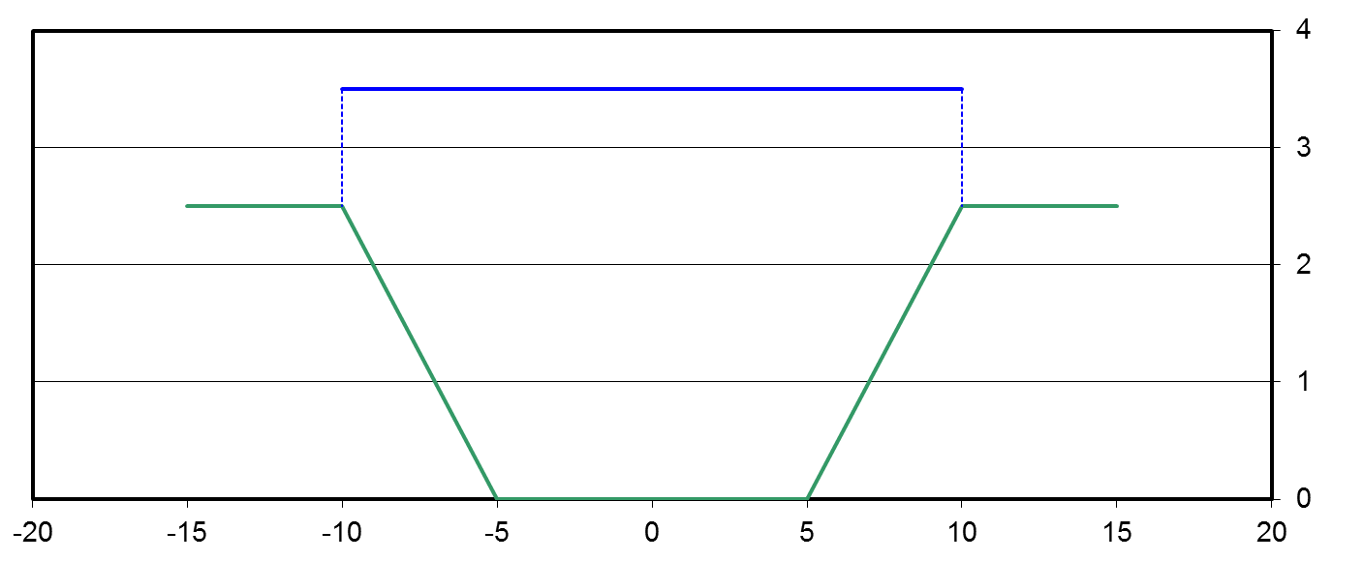
Channel Capacity
Notes:
Depth to activate floodplain storage
Only include flow area > channel
Floodplain flow low – not d/s, not continous path, high relative roughness, in and out of channel

Slide 25
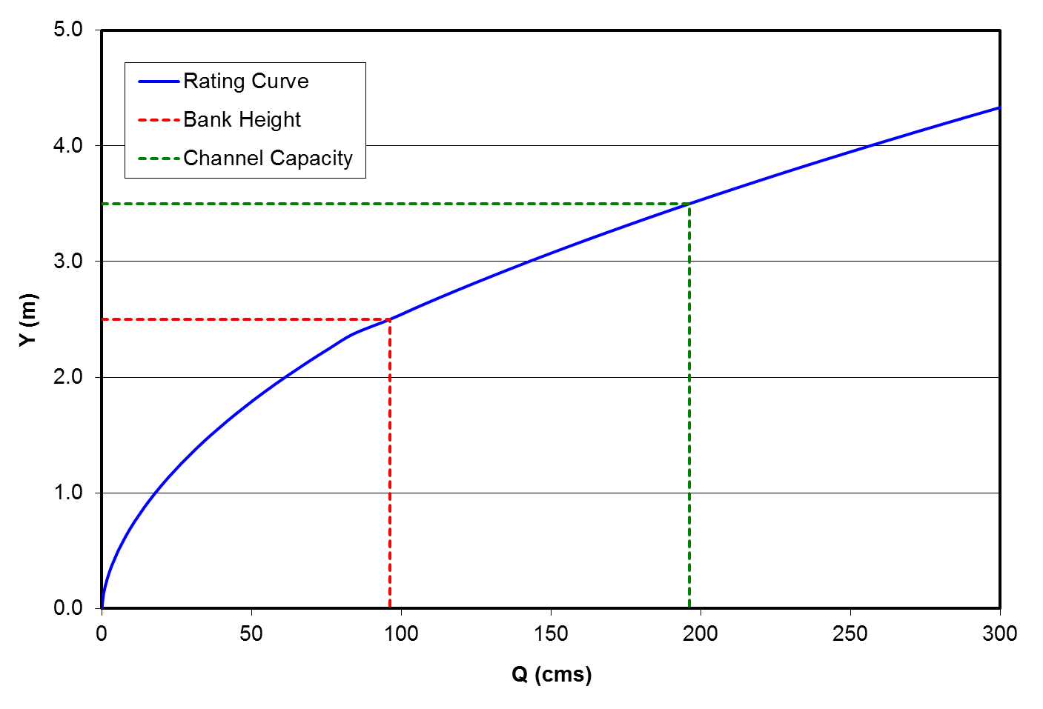
Channel Capacity
Notes:
Typical Rating Curve:
Qcc >> Qh
Increase in A and V due to increase in Y

Slide 26
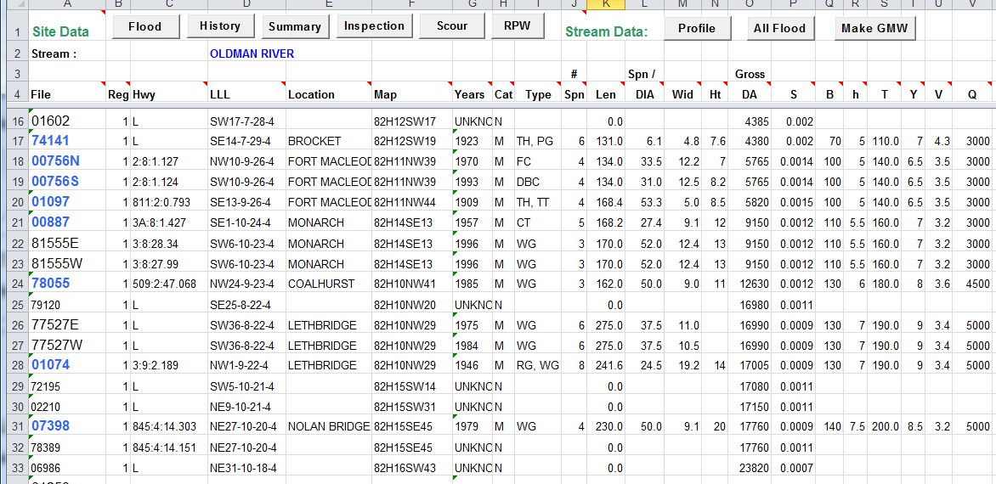
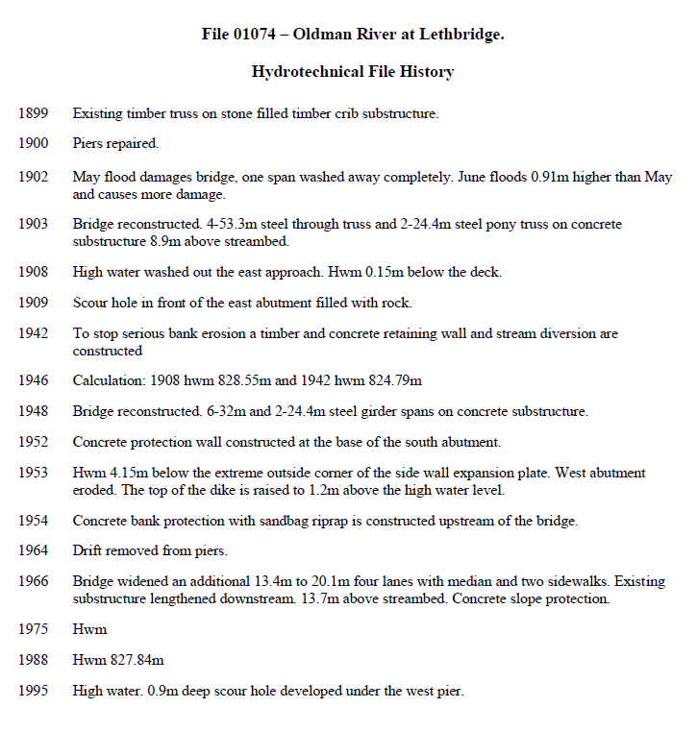
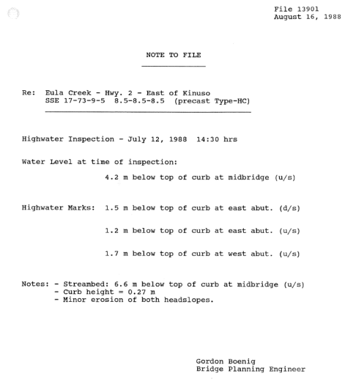
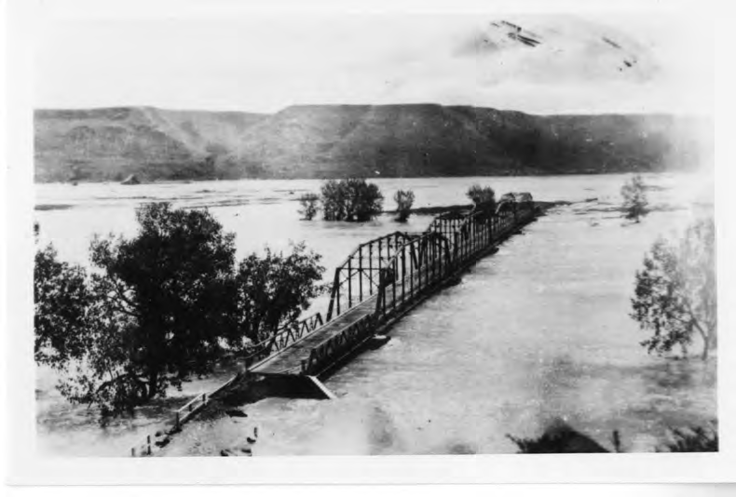

Historic Highwater - AT
Notes:
AT Records:
Access in HIS
Flood records and file histories
> 4000 event-site combinations – flood records
Photos, measurements
Look u/s and d/s for more coverage

Slide 27
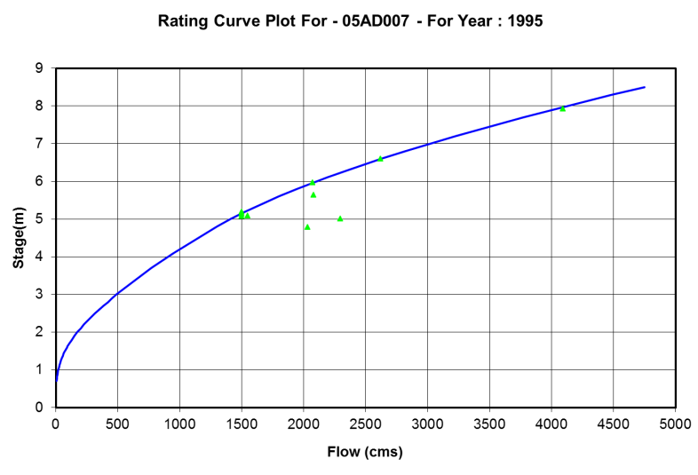
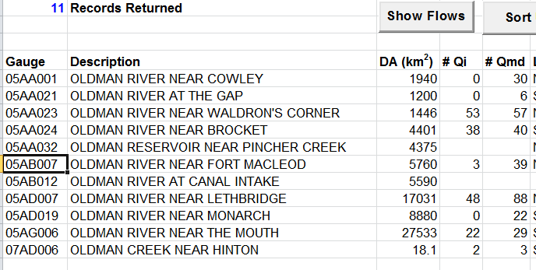
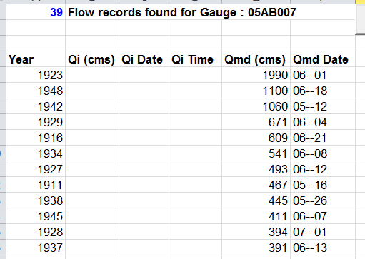


Historic Highwater - WSC
Notes:
WSC Records:
~1000 sites, ~ 400 active at any time
AT got access to raw data in addition to published, built tool to access and display
Provide published max mean daily Q, highest gaugings, processed hydrographs, and rating curve plots showing actuals

Slide 28
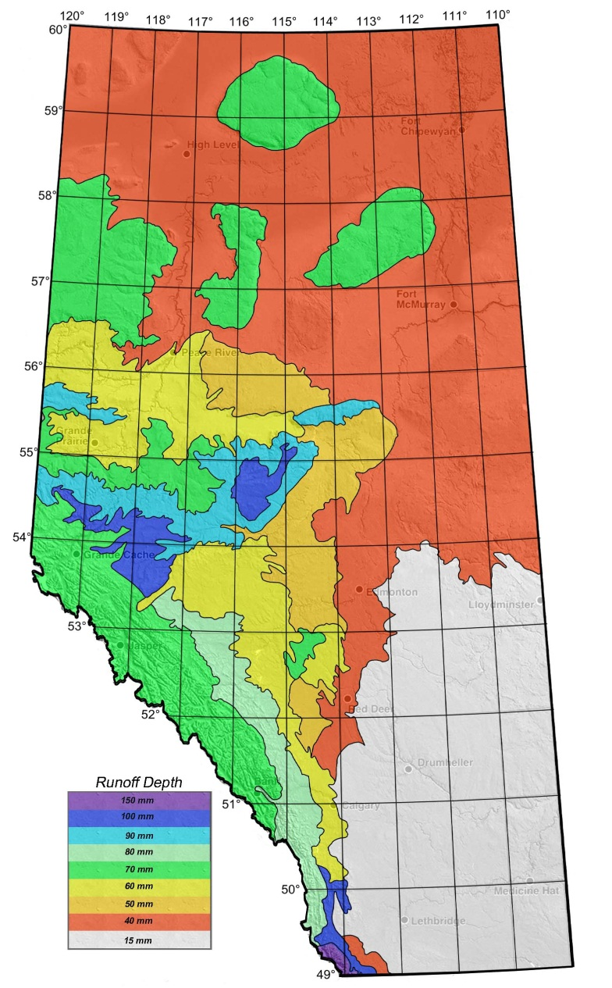
Basin Runoff Potential
Notes:
Basin Runoff Potential
Upper bound check – ability of basin to supply water if routing was not a constraint
Analysis of >3000 runoff events at WSC gauges
Geographic assignment based on envelope curves for distinct hydrologic districts
Map created for design use

Slide 29
Basin Runoff Potential
Q_{p}
d * A
T_{p}
Notes:
Application:
Derive drainage area through GIS/DEM
Set Tp = 20 hrs (conservative)
Determine unit discharge ‘q’ from ‘d’
Classic case :
Tributary to large stream
Small DA (km2)
End of channel steep and deep (ravine) – lots of capacity
Not enough water to fill it

Slide 30
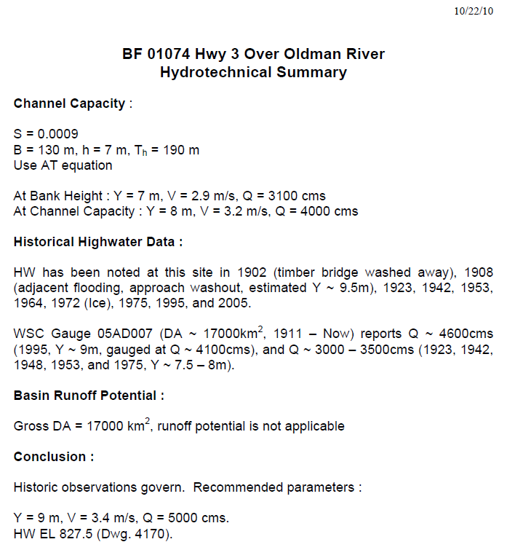
Notes:
Putting it all together:
Hydrotechnical summaries published for >1500 bridges (most of the big ones)
Combine 3 components to one set of parameters

Slide 31
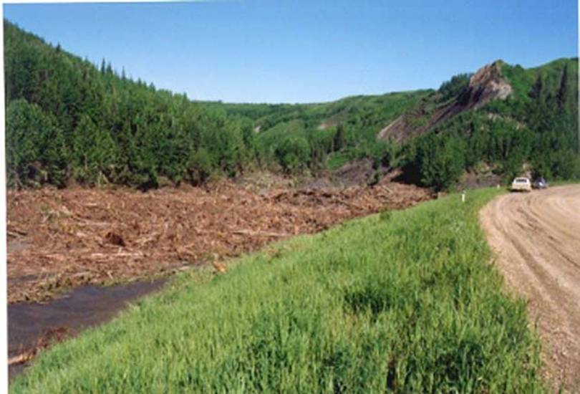
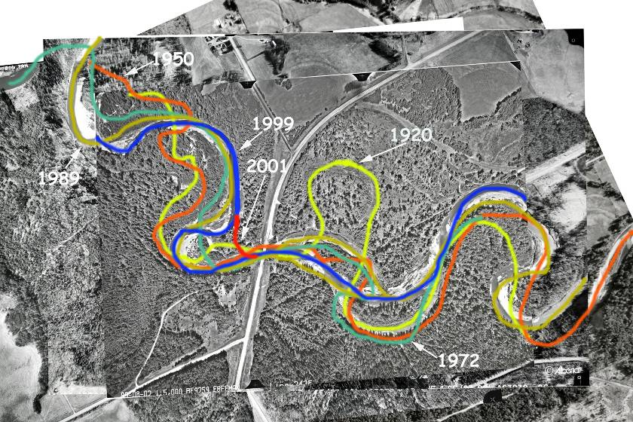
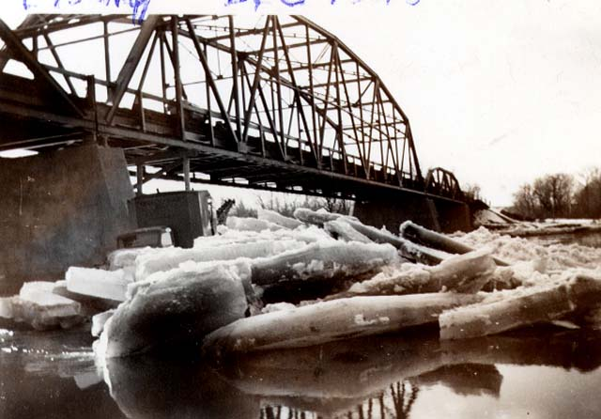
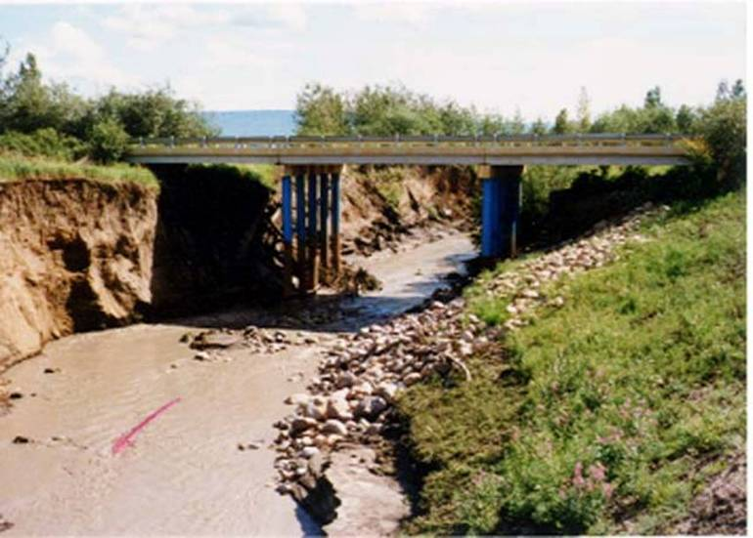
Notes:
Don’t be too precise:
Drift
Ice
Alignment changes
Channel changes

Slide 32


X
?
Notes:
Key Messages:
It matters
Should match physics, observations
HDG
Boundary condition – how to design for? – another story

Slide 33

Notes:
Climate change – flooding and storms more frequent, more intense?

Slide 34
Notes:
Storm frequency:
Rain events with > 150mm reported at multiple gauges
1960 – 2000 – relatively constant number of gauges
No observable trend in storm frequency

Slide 35
Notes:
Storm Magnitude:
Depth (mm) covering same area (10,000km2)
July 31, 1987 is the largest (Tornado storm, over Simonette River)
Jun 20, 2013 storm second biggest since 1960, but larger runoff prior – 1879, 1987, 1902, 1929, 1932
No visible trend in rainfall magnitude

Slide 36
Notes:
Storm Magnitude:
Depth (mm) vs. Area (km2)
Red line is prelim June 2013 Storm
Close to 1975 at eye, close to 1987 at 1000 – 10,000 km2 range
Definitely big, not completely out of range
Don’t have good data for late 1800 early 1900 storms, same or more runoff

Slide 37
Notes:
Flood Frequency:
~ 3700 flood records in HIS, back to 1879
Much fewer structures < 1960
Something, somewhere every year
Widest – 1974, 1982, 1986, 1990 (2), 1995, 2005 (2), 2013

Slide 38
Notes:
Flood Magnitude : WSC Gauge – NSR at Edmonton
Long continuous Record
Historic event recorded in 1899, other peaks in 1915, and 1952
No visible trend in peaks

Slide 39
Notes:
Flood Magnitude : WSC Gauge – Bow River at Calgary
Long continuous Record
Significant floods pre-record in 1879, 1897, and 1902 – photographic evidence, documented in floodplain studies
No visible trend in peaks
Long period between large floods (1995 storm was tracking for Bow basin)

Slide 40
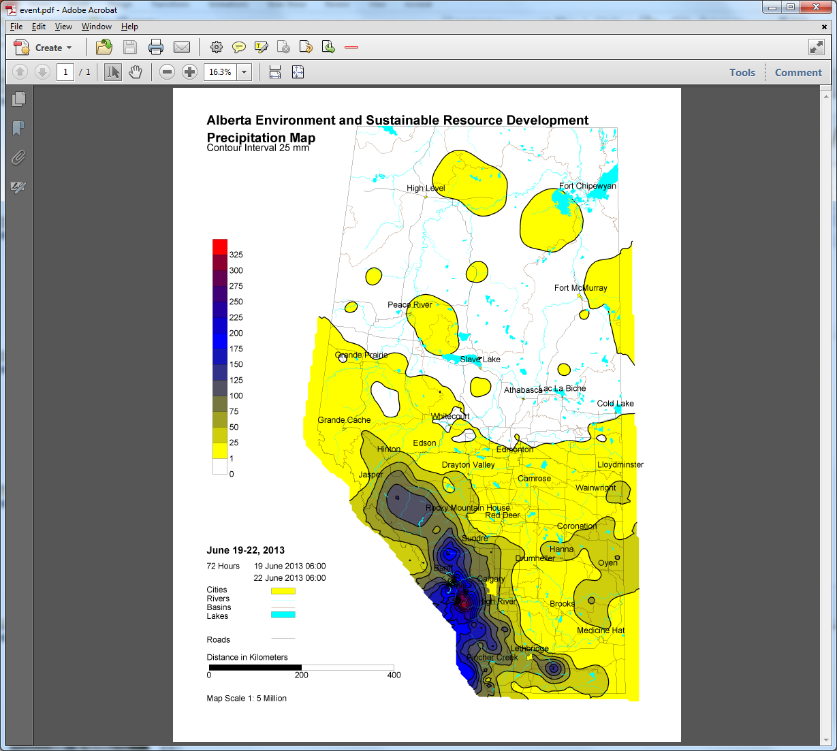
2013 Flood
Notes:
2013 Flood

Slide 41
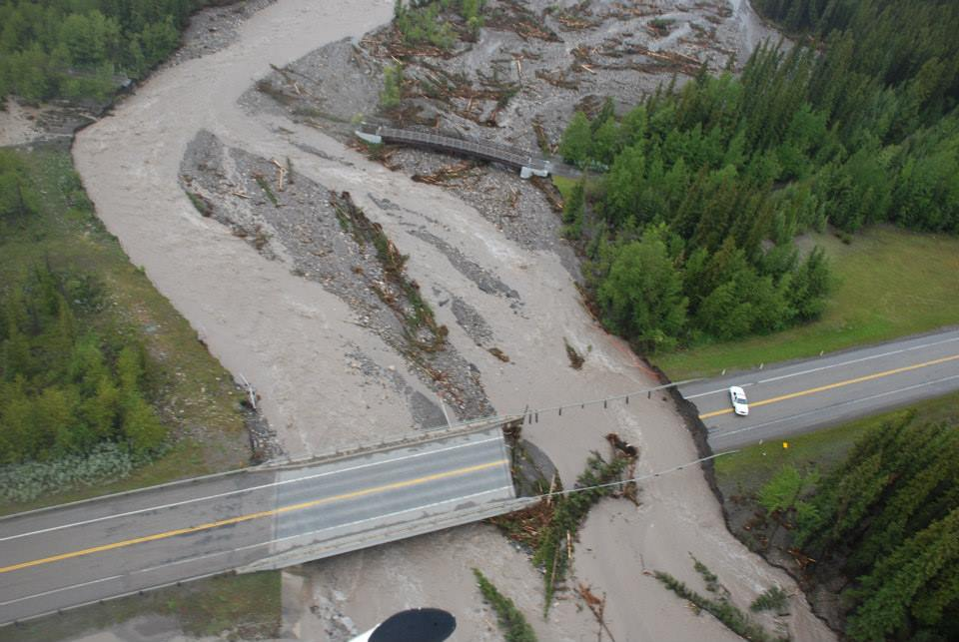
Notes:
Hwy 40 (and pedestrian trail) over Evan Thomas Ck (south of Kananaskis Golf Course)
Note drift impact
Note lateral instability
Opening OK, RPW not

Slide 42
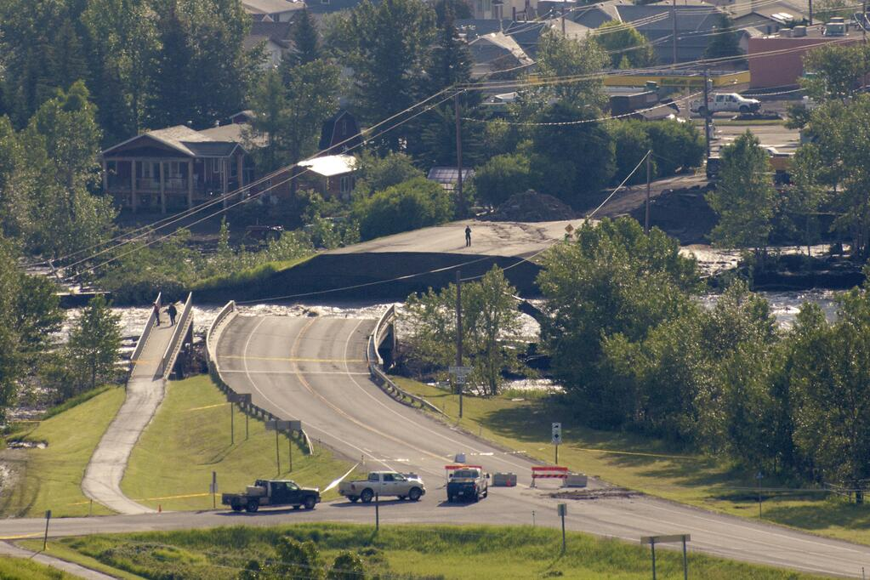
Notes:
Hwy 22 over Sheep River at Black Diamond
Bridge OK, road not
Insufficient RPW u/s right bank, campground

Slide 43
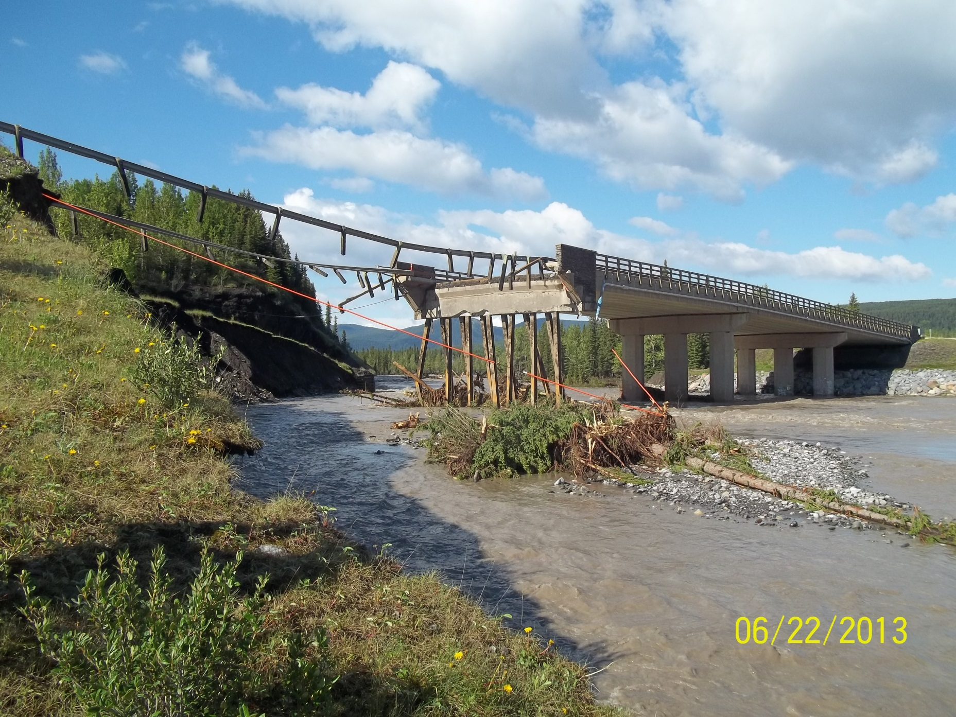
Notes:
Hwy 66 over Elbow River
Abutment washout and damage
Seems to be continual slumping, not realignment

Slide 44
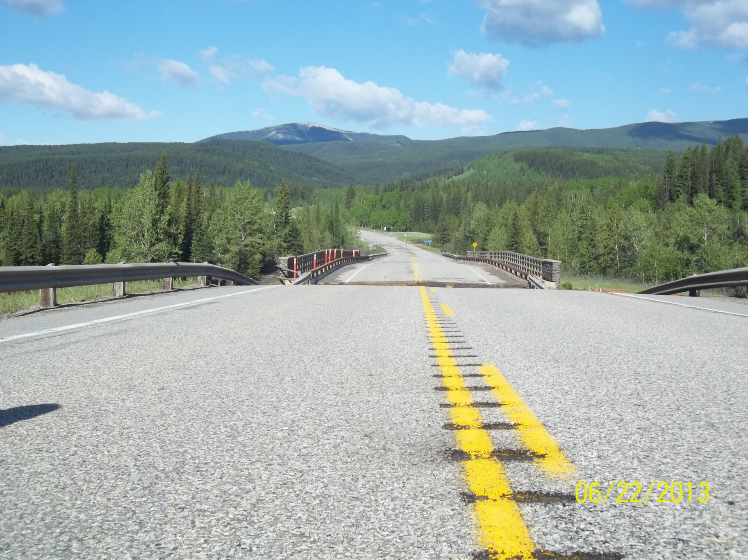
Notes:
Hwy 66 over Elbow River
Note considerable drop in elevation at abutment (~ 4 feet)
Will need a re-build of at least end span

Slide 45
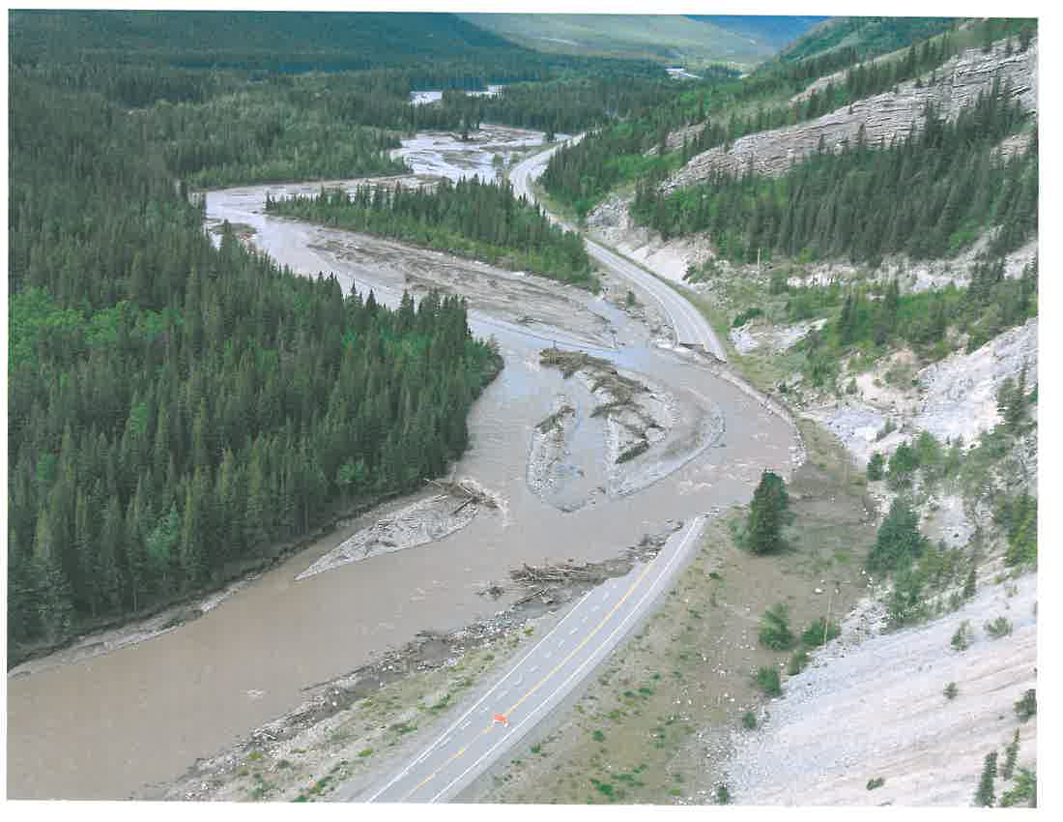
Notes:
Highwood River beside Hwy 541

Slide 46
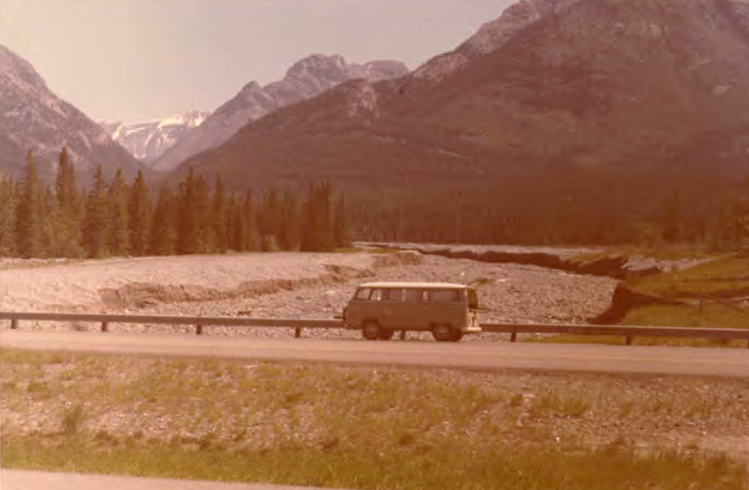
Notes:
Cougar Ck – Hwy 1:
Crossing alluvial fan
Note lateral mobility
Note lack of development
Post 1974 flood

Slide 47
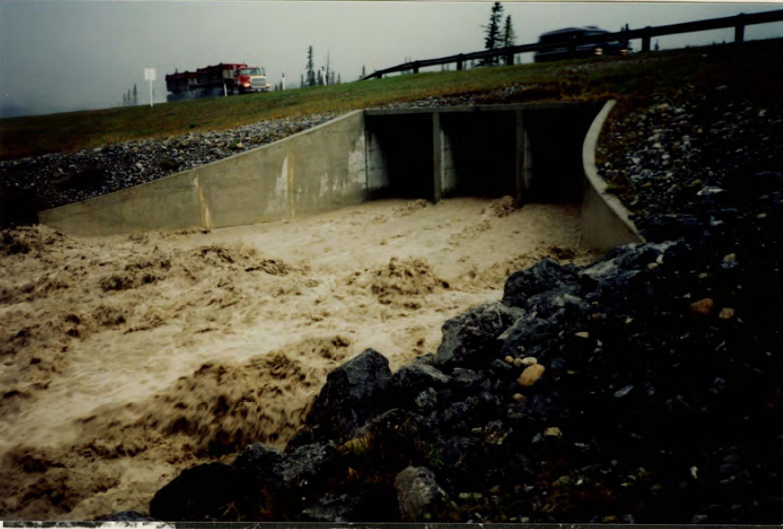
Notes:
Cougar Ck – Hwy 1:
Early in May 1990 flood
Culvert working OK before plugged
Note V, colour of water

Slide 48
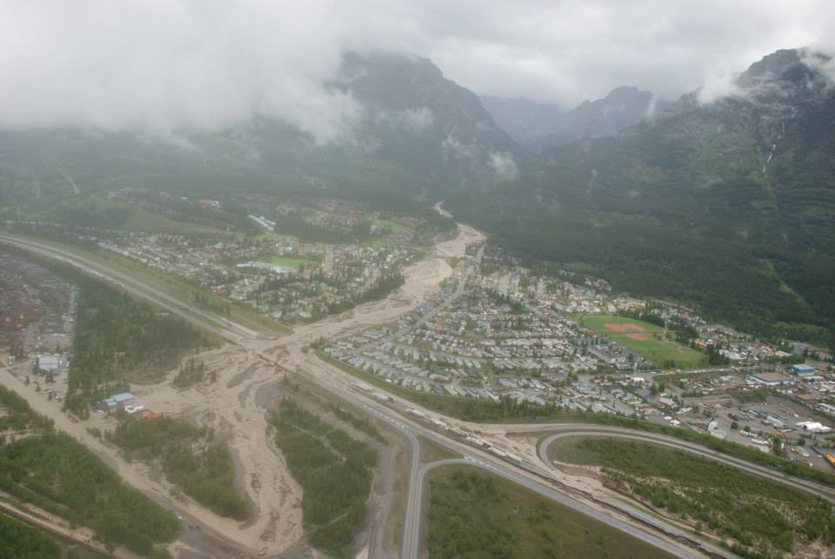
Notes:
Cougar Ck – Hwy 1:
Crossing alluvial fan
Debris flow
Closed for ~ 1 week
Note - lots of development adjacent to channel

Slide 49
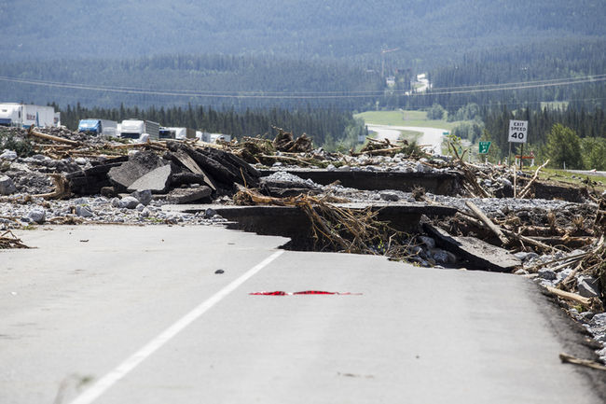
Notes:
Cougar Ck – Hwy 1:
Crossing alluvial fan
Debris flow
Closed for ~ 1 week
Note - damage, debris on top, trucks

Slide 50
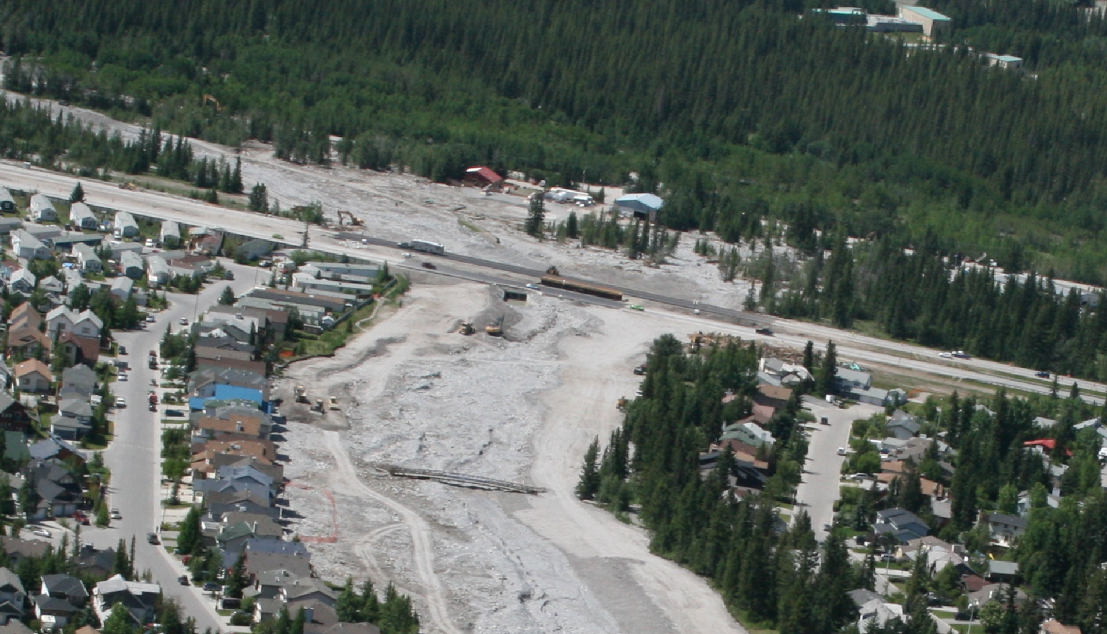
Notes:
Cougar Ck – Hwy 1:
1 week later, looking d/s
Highway now open – restricted speed, lanes
Difficulty in holding alignment, handling debris

